Slide 1
Leadership and SAE
Essential Standard 1.00: Understand leadership opportunities and SAE related to the agriscience industry

Slide 2
Objective 1.01
Understand the history, opportunities and structure of organizations related to the agriscience industry.

Slide 3
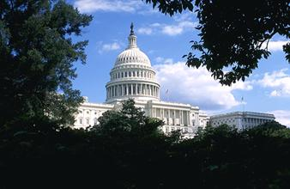
History of the National FFA Organization
1917 Smith-Hughes Act
established funding
vocational agriculture in high school
1920’s – Virginia was the first state to have Futures Farmers clubs
Boys only

Slide 4
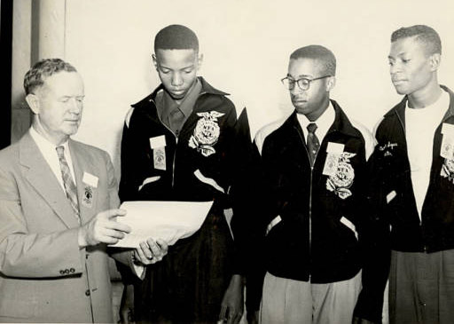
History of the National FFA Organization
1928 – FFA became a national organization
A network of teachers guided the establishment of FFA
Effort to establish a club for boys with similar farm interests
1935 – NFA was formed (New Farmers of America)
Black students studying agriculture

Slide 5
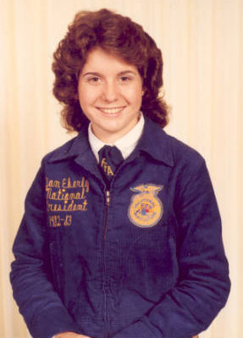
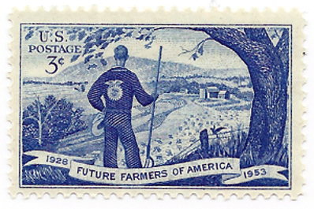
History of the National FFA Organization
1950 – Public Law 740
FFA became one of a few student organizations to receive a Federal Charter from Congress
1965 – FFA and NFA merged
1969 – Girls allowed in FFA for the first time

Slide 6
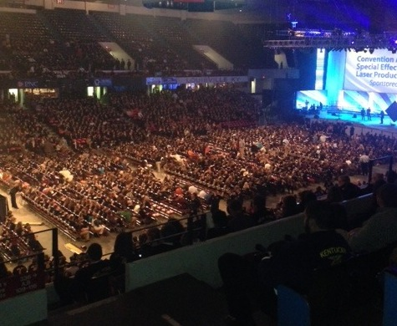
History of the National FFA Organization
1988 – Name change
Future Farmers of America to National FFA Organization
Reflects the growing diversity in the agriculture industry
2012 – National Convention moves to Indianapolis, Indiana

Slide 7
FFA Mission
FFA makes a positive difference in the lives of students by developing their potential for premier leadership, personal growth and career success through agricultural education.
Promotes teamwork, cooperation, and citizenship

Slide 8
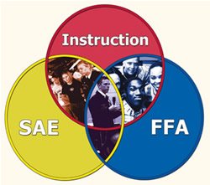
SAE
Supervised Agricultural Experience
Component used to help students learn to keep records, perform practical job skills, and gain opportunity for work and exploratory experience in Agriscience

Slide 9
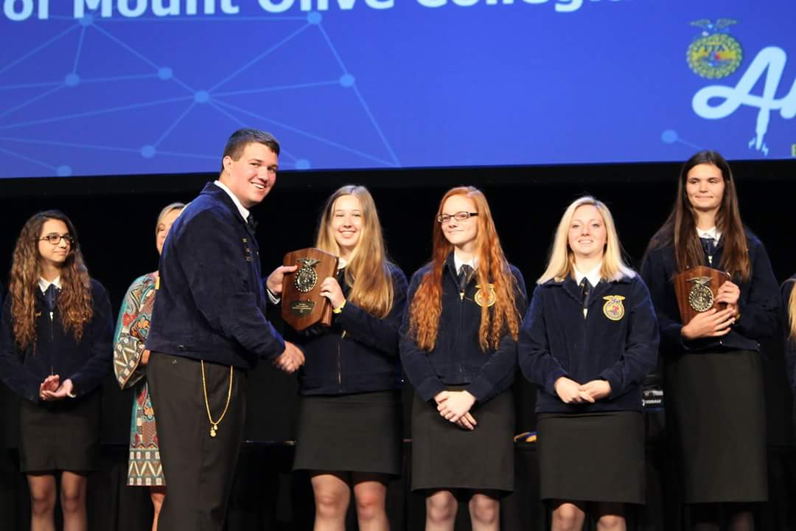
Opportunities within the FFA
Career Development Events (CDE’s)
Competitive Events - benefits
Most events progress from the local (chapter) to the federation, regional, state and national level.
Develops technical and leadership skills as well as confidence.
Recognition is received and prize money is often received for 1st place state finish.

Slide 10
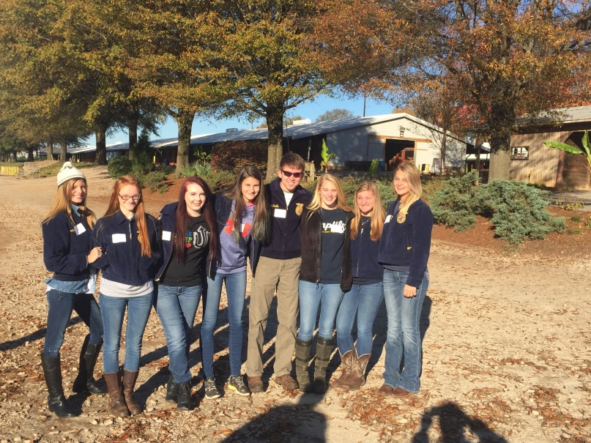
Opportunities within the FFA
Career Development Events (CDE’s)
Animal Science Competitive Events - examples
Dairy Evaluation
grade and evaluate dairy cattle
Poultry Evaluation
grade and evaluate chickens and chicken products
Livestock Judging
grade and evaluate beef cattle, sheep, swine and goats
Horse Judging
evaluate several classes of horses and present oral reasons

Slide 11
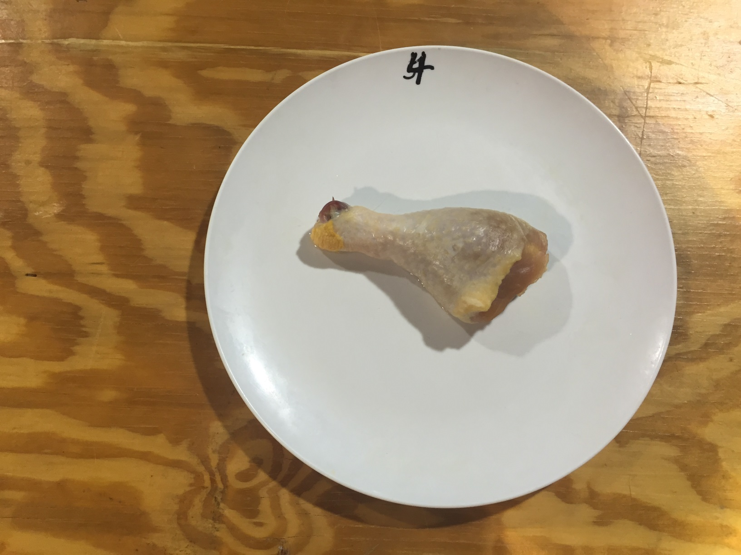
Can you Identify this parts?

Slide 12
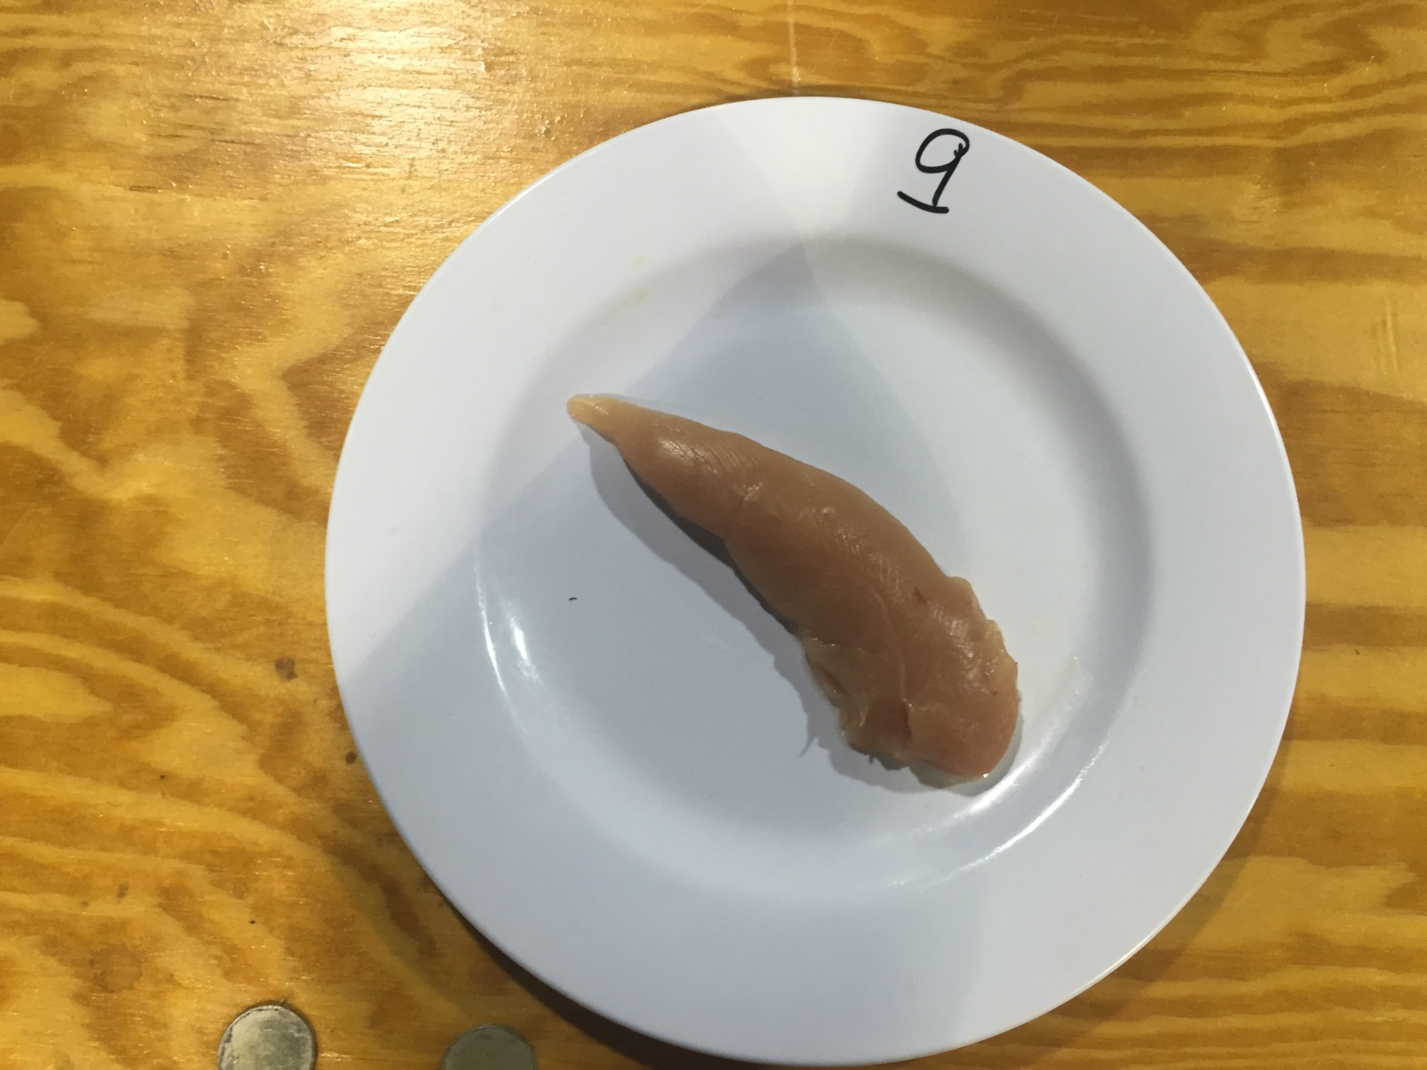
Can you Identify this parts?

Slide 13
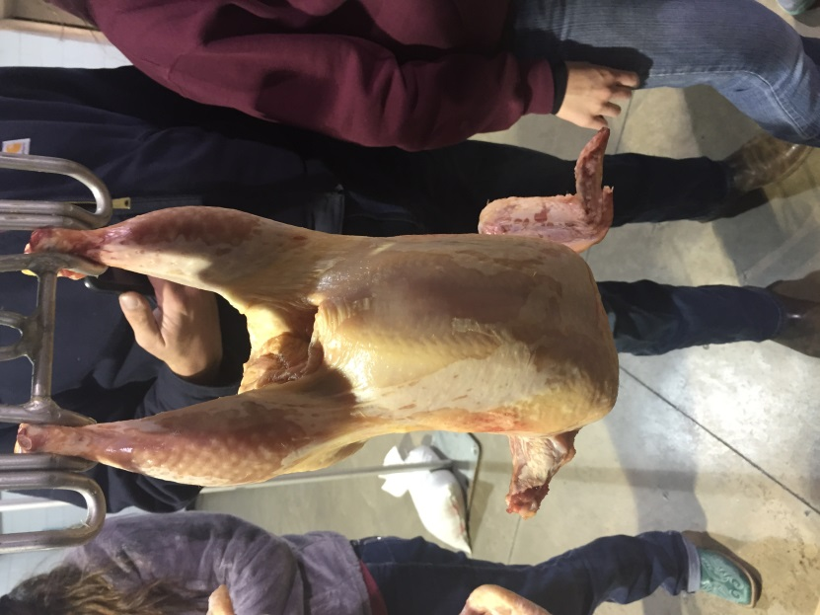
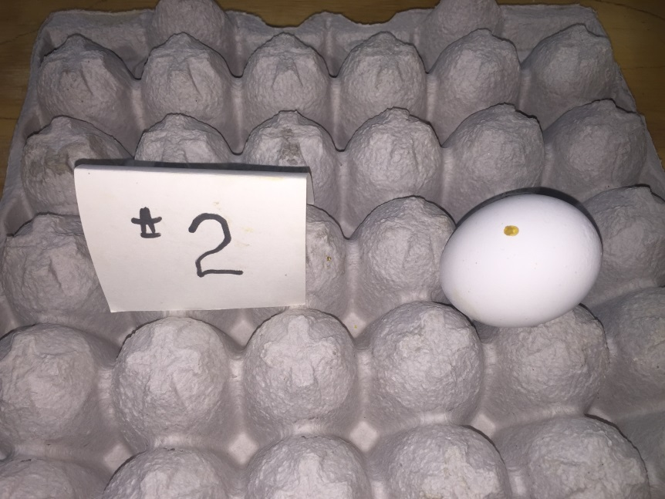
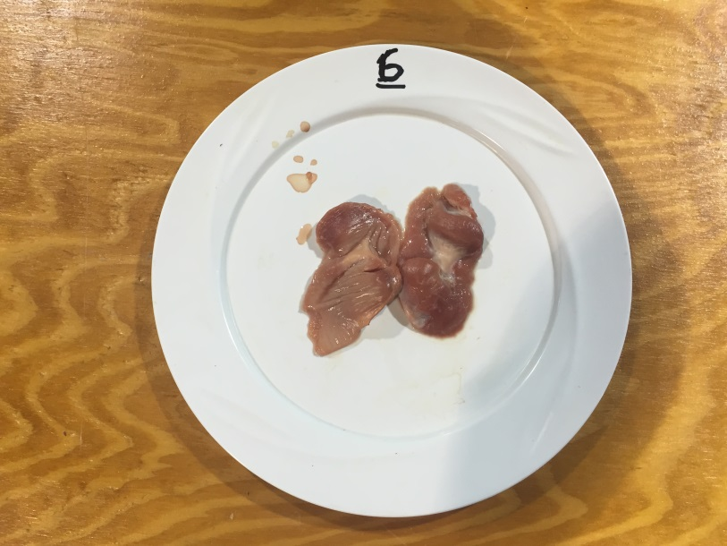
Poultry Judging CDE

Slide 14
Opportunities within the FFA
Career Development Events (CDE’s)
Plant Science Competitive Events - examples
Introduction to Horticulture
knowledge of horticulture and plant identification
Nursery/Landscape
knowledge of the nursery and landscape industry and plant identification
Floriculture
knowledge of floral arrangement , horticulture and plant identification
Forestry
identification of trees and forestry tools as well as measurement of trees

Slide 15
Name this plant.

Slide 16
Opportunities within the FFA
Career Development Events (CDE’s)
Leadership Competitive Events - examples
Creed speaking
recitation of the FFA creed.
Prepared Public Speaking
prepare and present a 6-8 minute speech on an agriculturally related topic of your choice
Extemporaneous Public Speaking
present a 4-6 minute speech on a topic given to you with 30 minutes preparation time
Parliamentary Procedure
present a mock business meeting
solve business problems and knowledge of business principles

Slide 17
Opportunities within the FFA
Career Development Events (CDE’s)
Agriculture Business Competitive Events - examples
Job Interview
performance of a mock interview for an agriculturally related job
Agricultural Sales
knowledge of sales and marketing
Farm Business Management
solve business problems and knowledge of business principles

Slide 18
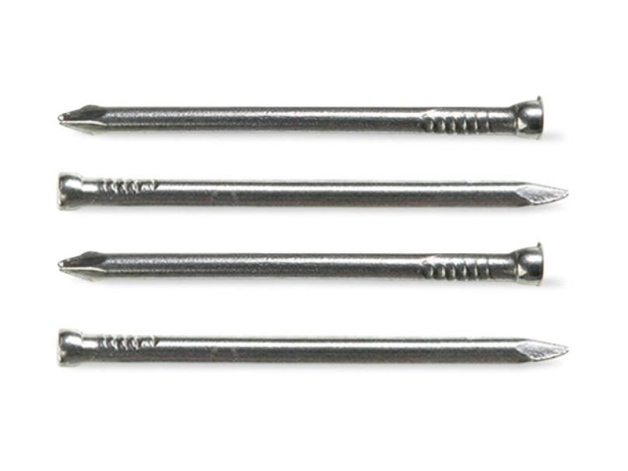
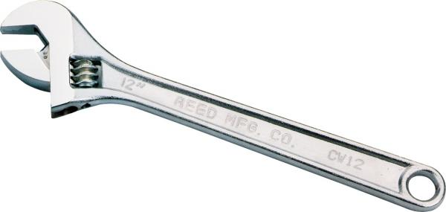
Opportunities within the FFA
Career Development Events (CDE’s)
Agriculture Mechanical Competitive Events - examples
Agricultural Tools and Materials
knowledge and identification of tools
Agricultural mechanics
knowledge of agricultural mechanics as well as performance of specific mechanical skills

Slide 19
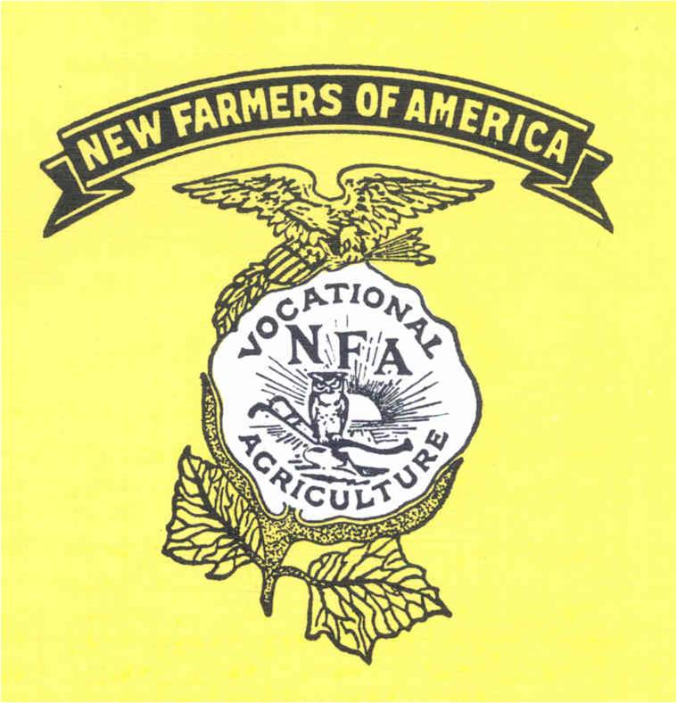

Slide 20
Agricultural Organizations related to the Agriscience Industry
Goals
Allow professionals the opportunity to network, learn, and communicate
Provide trade shows and journals
update members on new methods, products, and technology
Uses membership dues
commodity advertisement
trade journals
educational programs
scholarships for members

Slide 21
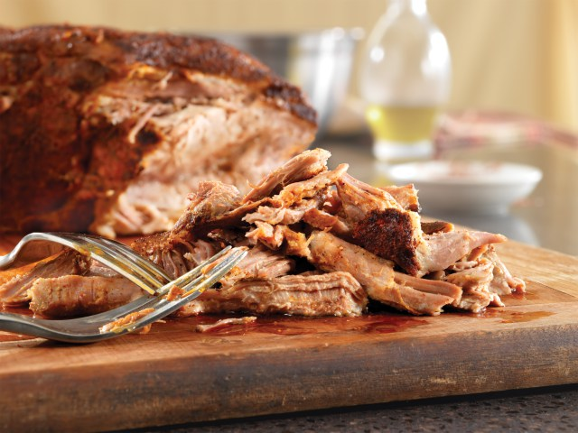
Agricultural Organizations related to the Agriscience Industry
Usually Commodity related
Corn Growers Association (NCGA)
to create and increase opportunities for corn growers
North Carolina Pork Producers Council (NPPC)
promotes and educates a socially responsible and profitable NC pork industry

Slide 22
Agricultural Organizations related to the Agriscience Industry
North Carolina Nursery and Landscape Association (NCNLA)
flexible, knowledgeable, responsive, environmentally- conscious organization
provides the nursery and landscape industries with leadership, technological and business advancement opportunities and information services
American Quarter Horse Association (AQHA)
world’s largest breed registry and membership organization
North Carolina Christmas Tree Association (NCCTA)
promotes “real” Christmas trees through marketing and education

Slide 23
Agricultural Organizations related to the Agriscience Industry
NC Farm Bureau
unified voice in agricultural issues
offers insurance
provides scholarships and educational opportunities for youth
Carolina Farm Stewardship Assoc. (CFSA)
farm driven, membership based, non-profit, that helps people in the Carolinas grow and eat local, organic foods……
Grange
is a family–oriented organization
serves its members through a variety of programs and promotes agriculture as an essential industry for our economy
FFA Alumni
open to those who wishes to support students in agricultural education

Slide 24
Activity
Pick an agriculture organization from the list below:
Create an Informational Flyer that describes your organization by:
NC Farm Bureau
The Grange
American Quarter Horse Association (AQHA)
North Carolina’s Pork Producers Council
FFA Alumni
North Carolina Nursery and Landscape Association (NCNLA)
NC Cattlemen’s Association
American Dairy Goat Association (ADGA)
Including a visual
Explaining their purpose
Explaining membership requirements

Slide 25
Objective 1.02
Understand effective leadership and communication skills.

Slide 26
Leadership Development in FFA
1. Purpose
Develops confidence, character and citizenship
Builds cooperative attitudes that help students work with others
Encourages the improvement of scholarship

Slide 27
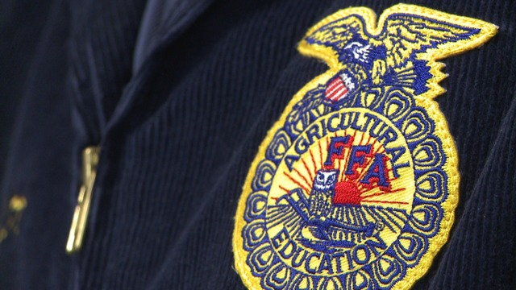
Leadership Development in FFA
2. Ways and Means
Develop an appreciation of FFA traditions
Colors- National Blue and Corn Gold
Program of Activities (POA)
calendar of activities that provides fun opportunities for members, creates a better chapter and provides service to the local community

Slide 28
Leadership Development in FFA
2. Ways and Means continued
Symbols and their meaning:
Eagle
National Scope of FFA
Plow
Labor and tillage of the soil
Owl
Knowledge and wisdom
Rising Sun
Progressive nature of agriculture
Need for cooperative effort to reach common goals
Ear of corn
Unity
FFA is a national organization with members from across the U.S. and Puerto Rico
Lettering “Agricultural Education” and “FFA”
signifies the combination of learning and leadership

Slide 29
Leadership Development in FFA
2. Ways and Means continued:
The FFA Motto:
Learning to Do
Doing to Learn
Earning to Live
Living to Serve

Slide 30
Leadership Development in FFA
2. Ways and Means continued
Serving in leadership roles as an FFA Officer
President (rising sun)
presides over meetings
Vice president (plow)
coordinates all committee work
Secretary (ear of corn)
keeps records of all meetings
Treasurer (bust of Washington)
keeps financial records
Reporter (flag)
public relations
Sentinel (hand clasp and shield of friendship)
welcomes guests and visitors

Slide 31
Leadership Development in FFA
2. Ways and Means continued
Other opportunities to develop leadership in FFA
Leaderships schools, camps and conferences (WLC)
Committee involvement (Community service committee)
State and National Conventions
Raleigh, North Carolina in June
Louisville, Kentucky in October
Competitive events

Slide 32
Parliamentary Procedure
What is Parliamentary Procedure?
Watch this video and take notes on a SEPARATE SHEET OF PAPER.
Once the video is complete, we will begin talking about Parliamentary Procedure specifically highlighting FFA traditions and uses.

Slide 34
Conducting Business Meetings (Agenda)
Agenda
Call to order by the President
Opening ceremony in FFA meetings
Minutes of the previous meeting
read by the Secretary
approved by the body in accordance to organizational by-laws and parliamentary procedure
reminds members of what occurred at the last meeting
Treasurer reports
Report on Chapter Program of Activities (POA)
presented by officers and committee chairperson
Old Business
New Business
presented by members in the form of motions
Adjournment and closing ceremony
occurs by either passing a motion or by consensus of the body

Slide 35
Conducting Business Meetings (Agenda)
Purpose for an agenda
The agenda keeps the meeting moving forward
The agenda forms the framework for the development of a good meeting
Little Rascals Opening Ceremony

Slide 36
General Principles of Parliamentary Procedure
Extends courtesy to everyone
Members must be recognized to speak
except in cases of emergency or to enforce parliamentary law
Members ask the president for recognition to speak
standing and saying ” Madame/Mr. President”
Focuses on one thing at a time
only one motion on the floor at a time
a main motion is presented by saying “I move to/that…”
Robert's Rules Online

Slide 37
General Principles of Parliamentary Procedure
Observes the rule of the majority
Only main motions that have been seconded can be discussed
Most motions require a simple majority to pass
Action only after the passing of a motion
Ensures the rights of the minority
Everyone has the right to voice their opinion during discussion of a motion regardless of which side they may be on
Therefore, a motion to stop discussion requires a 2/3 vote to pass
20 out of 30 would have to vote to end discussion

Slide 38
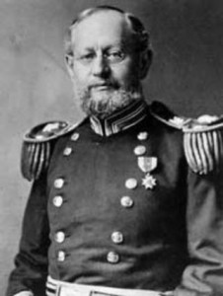
Main Motion
Introduce new business
Address the presiding officer
Receive recognition to speak
State the motion
“I move that our FFA chapter conduct a community service project.”
Someone seconds the motion
Discussed by the group
Vote
Chair announces result of vote
Requires a second
Debatable
Amendable
Majority vote required

Slide 39
Amendment
Alter or change a motion
adding
striking out
Substituting
Requires a second
Debatable
Amendable
Majority vote required

Slide 40
Refer to a Committee
To put the motion in the hands of a small group
“I move to refer this motion to a committee of three people appointed by the chair, who will report back at the next regular meeting”
Requires a second
Debatable
Amendable
Majority vote required

Slide 41
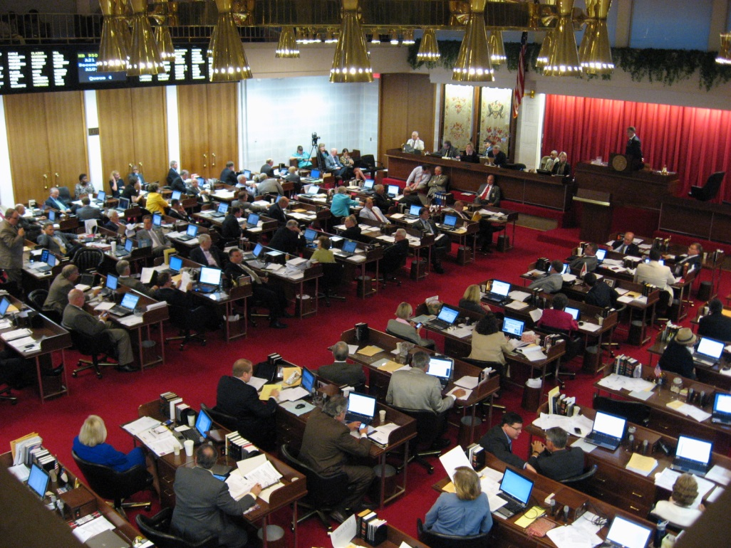
Previous Question
Introduce new business
“I move the Previous Question.”
Requires a second
Not Debatable
Not Amendable
2/3 Majority vote required

Slide 42
Suspend the Rules
Allow the chapter to act in a way that would be against the rules of parliamentary law.
“I move to suspend the rules and waive the reading of the minutes.”
Requires a second
Not Debatable
Not Amendable
2/3 Majority vote required

Slide 43
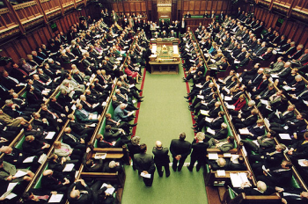
Point of Order
Enforces the rules of parliamentary law.
“I rise to a Point of Order.”
No second required
Not Debatable
Not Amendable
No vote taken

Slide 44
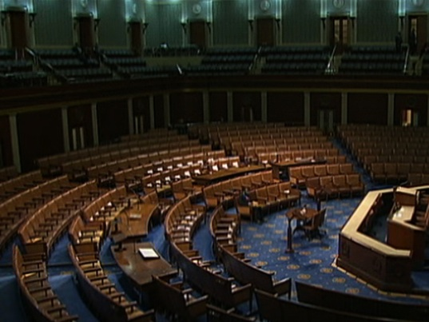
Adjourn
Ends the meeting
“I move to adjourn.”
Second required
Not Debatable
Not Amendable
Majority vote required

Slide 45
Voting
Common methods
Voice vote
by saying “aye” or “no”
Rising vote
Standing
show of hands
Secret ballot
written vote
Roll call
each member speaking their vote when the secretary calls their name

Slide 46
Gavel
Taps are used to signal members of action they should take or to signal the completion of a parliamentary action
One tap
follows announcement of adjournment
follows the completion of a business item
to be seated
Two taps
signal the official start of the meeting and calls the meeting to order
Three taps
are used to signal all members to stand
members are to rise in unison at the third tap of the gavel

Slide 47
Public Speaking
Oral communication skills are one of the most important factors in determining career success
The FFA Creed
gives students the opportunity to develop basic public speaking skills
helps to develop confidence
Oral communication can be improved through practice (and more practice)
Practice improves the speaker stage presence
Attitude
Confidence
Personality
Ease before the audience
Personal appearance
Poise
Posture

Slide 48
The FFA Creed
History
Written by E.M. Tiffany
Adopted at the 3rd National FFA Convention in 1930
Revised in 1965 and 1990
Each of the 5 paragraphs begins with “I believe……”
Use
Basic statement of beliefs that helps members understand the importance of FFA
Expresses belief in work ethic, fairness, patriotism, and tradition that all members can share
Requirement for the first degree of FFA membership
Greenhand Degree

Slide 49
Objective 1.03
Understand the importance of SAE to work-based learning.

Slide 50
SAE – What is it?
1. An individualized project
Supervised Agricultural Experience
Conducted outside of the regularly scheduled school day
2. Makes up the third part in a total agricultural education program
Classroom /laboratory instruction
FFA
SAE
3. SAE is for every student
A percent of your course grade

Slide 51
Purpose of SAE
Opportunities to explore a variety of subjects
Educational and practical experience in a specialized area
Opportunities for earning while learning
Teaches accurate computerized or written records
Win FFA awards
FFA proficiency awards

Slide 52
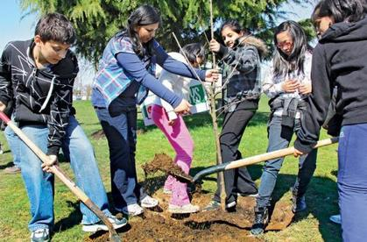
Types of SAE
Exploratory
Short duration usually
Students become more literate in agriculture
Develop awareness of agricultural careers
Examples:
Observing and/or assisting a veterinarian
Interviewing a landscape contractor
Shadowing a greenhouse employee
Observing/assisting a welder
Attending a career day/fair

Slide 53
Types of SAE
Entrepreneurship
Ownership or part-ownership
assume financial risk
Skills necessary to become established in one’s own business
Types of Entrepreneurship
Production SAE
Raise and sell an agricultural commodity for profit
Examples: produce vegetables, grow Christmas trees, raise livestock, dogs, or horses, grow field or nursery crops.
Agribusiness SAE
Students own and operate an agricultural related business
Examples: lawn maintenance or landscaping business, crop scouting service, pet sitting service, feed sales, computer service for farms, horse riding lessons

Slide 54
Types of SAE
Placement
Students obtain a job with an employer
often with the help of their instructor
Typically paid an hourly wage
Examples:
Placement in Production
on a farm
greenhouse
nursery or other production facility
Placement in Agribusiness
work at a veterinary clinic
florist
feed store
landscaping business

Slide 55
Types of SAE
Improvement
Activities are done to improve the appearance, convenience, efficiency, safety or value of a home, farm or other facility.
No wages earned
No ownership necessary
Examples:
landscape parent or grandparent’s home
building a fence
building a storage shed
growing herbs or vegetables in containers on a porch or patio
assist with landscape maintenance at an apartment complex

Slide 56
Types of SAE
Analytical
Students choose an agricultural problem not easily tested by experimentation
Gather and evaluate data
Non-experimental
Examples:
Develop marketing plan for poinsettia crop
Research and present project on effects of temperature change on corn yields in South America

Slide 57
Types of SAE
Experimental
Students conduct and an agriculturally related experiment
Scientific method
Examples:
Compare the effects of various rates of nitrogen on poinsettias
Compare the effects of various feeds on average daily gain in lambs
Can be used to compete in the State Agriscience Fair.

Slide 58
Types of SAE
Supplementary
Activities are short-term activities with little or no planning involved
Skill specific, non- wage earning
Examples:
learning to prune peach or apple trees
changing hydraulic fluid in a tractor
mowing a baseball infield or putting green
trimming sheep feet
bottle feeding dairy calves

