Slide 1
Animal Science
Essential Standard 4.00: Understand the animal industry (large animal, poultry, equine, and aquaculture)

Slide 2
Objective 4.01
Remember careers in the animal industry.

Slide 3
Major Animal Science Industries:
Large animal (livestock)
Defined: Farm animals raised to produce milk, meat, work and wool.
Examples: Cattle, sheep, swine, goats
Poultry
Defined: Any or all domesticated fowls that are raised primarily for their meat, eggs or feathers.
Examples: chickens, turkeys, ducks, geese

Slide 4
Major Animal Science Industries:
Equine
Defined: Horses or other members of the family Equidae.
Examples: Horses, mules
Aquaculture
Defined: Underwater agriculture, commonly called fish farming. Also includes the growing of water vegetation such as kelp.
Examples: Tilapia, trout, catfish, shrimp

Slide 5
Examples of animal science careers
Animal nutritionist – one who studies nutrient values of feeds, including how digestible they are.
Veterinarian – an animal doctor.
Geneticist – a person who studies and applies genetics.
Animal Technician– one who cares for and manages. animals in a variety of settings including animal hospitals.

Slide 6
Examples of animal science careers
Farm/Herd Manager – manages the daily operation of a livestock farm.
Horse Breeder/Trainer – breeders are in charge of the record keeping and scheduling involved with being a breeder.
Farrier –a person who shoes horses.
Veterinary Technician– assists the veterinarian in caring for animals.

Slide 7
Examples of animal science careers
Butcher - a person who slaughters animals or dresses meat.
Meat Inspector – a trained individual employed by regulatory authorities to inspect all meats as they pass through a slaughter facility or packing plant.
Artificial breeding Technician – a person certified to artificially breed livestock.
Sales representative, Animal Health Products – a person who sells animal health products to veterinarians and stores that sell these products.

Slide 8
Examples of animal science careers
Poultry Hatchery Manager – a person who manages the daily operation of a hatchery facility.
Equine Dentist – specialized dentist who works on horses.
Equine Magazine Writer – a person write articles about the horses and the horse industry.
Microbiologist – a scientist concerned with the study of plant and animal microorganisms.

Slide 9
Objective 4.02
Understand biotechnology in the animal industry.

Slide 10
Biotechnology in the Animal Science Industry
Animal cloning
For product uniformity
drumstick uniformity in the poultry industry
Saving endangered species
New animals could be reproduced from the tissue of remaining animals
Research purposes
Genetically identical animals are better for research studies that try to isolate one variable

Slide 11
Biotechnology in the Animal Science Industry
Biotechnology in Animal Reproduction and Production
BST (Bovine somatotropin)
A hormone produced in the pituitary gland of cattle
increases milk production
Method of gene splicing genetic material into E. coli bacteria
Produced at relatively low cost
Dairy cows given BST will produce more milk

Slide 12
Biotechnology in the Animal Science Industry
Biotechnology in Animal Reproduction and Production
Artificial Insemination (AI)
Process involves the introduction of the male sperm into the reproductive tract of a female
By means other than the natural mating process
Most of the cows in the dairy industry are produced through AI

Slide 13
Biotechnology in the Animal Science Industry
Biotechnology in Animal Reproduction and Production
Embryo Transfer
Transferring of embryos from one female to another
One female can produce many calves in a year due to superovulation
donor animal to release several eggs instead of just one
A superior female can be fertilized by genetics from a superior male
resulting embryos implanted into inferior female animals

Slide 14
Objective 4.03
Understand basic animal principles and practices.

Slide 15
Dairy Industry
Breeds
Holstein
black and white markings
produces the most milk
Ninety percent of dairy cattle in the US
Jersey
smallest dairy breed
second most popular breed
number one rank in butterfat
Guernsey
Fawn and white
Ayrshire
Cherry red and white

Slide 16
Beef Industry
Predominant English breeds in the U.S.
Angus
black color
known for excellent meat quality
Hereford
both horned and polled
red cattle with a white face

Slide 17
Beef Industry
Exotic breeds
Imported into the U.S. when consumers began demanding leaner meat
Grow faster than English breeds

Slide 18
Beef Industry
American breeds
developed to withstand heat
resistance to disease and parasites
Resulted from crossing Brahman cattle from India with English breeds
increased heat tolerance and disease and parasite resistance of Brahman and the meat quality of the English breeds
Example: Brangus
result of Brahman x Angus.

Slide 19
Swine Industry
Changed greatly from the lard type hogs of the past to the lean type hogs
Types of swine operations:
Feeder –pig producers
Market –hog producers
Farrow to Finish producers

Slide 20
Swine Industry
Purebred producers produce high-quality boars
Improves the genetic make-up of one breed of swine
Purebred boars bred to crossbred sows increase hybrid vigor (ex. muscling).
Duroc, Hampshire and Yorkshire are the most popular U.S. purebred breeds today

Slide 21
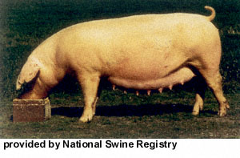
American Landrace

Slide 22
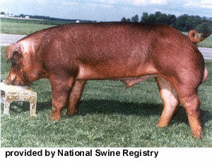
Duroc

Slide 23
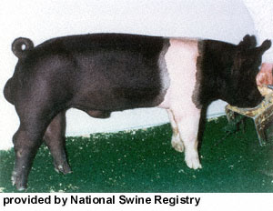
Hampshire

Slide 24
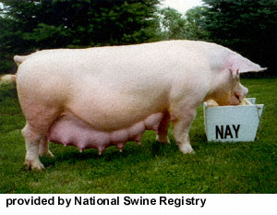
Yorkshire

Slide 25
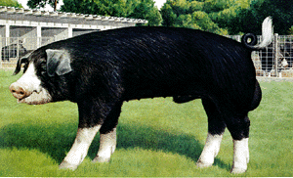
Poland China

Slide 26
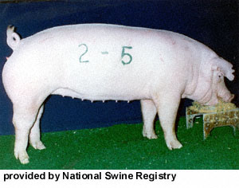
Chester White

Slide 27
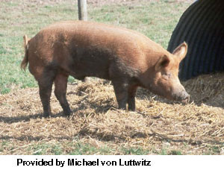
Tamworth

Slide 28
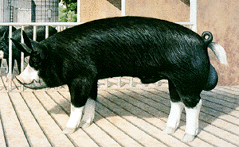
Berkshire

Slide 29
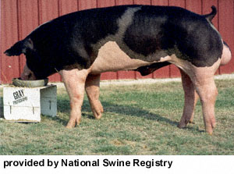
Spotted Swine

Slide 30
Poultry Industry
Classified as layers or broilers
Broilers are young chickens grown for their meat
Trace their ancestors back to the Cornish breed
Layers are chickens developed to produce large numbers of eggs
White leghorn –foundation breed

Slide 31
Poultry Industry
Breeds
White Leghorn (layer)
white bodied with red combs
Broiler and layer types used in industry today result from crossbreeding
Turkeys
90% of commercially raised turkeys are the Broad-Breasted White

Slide 32
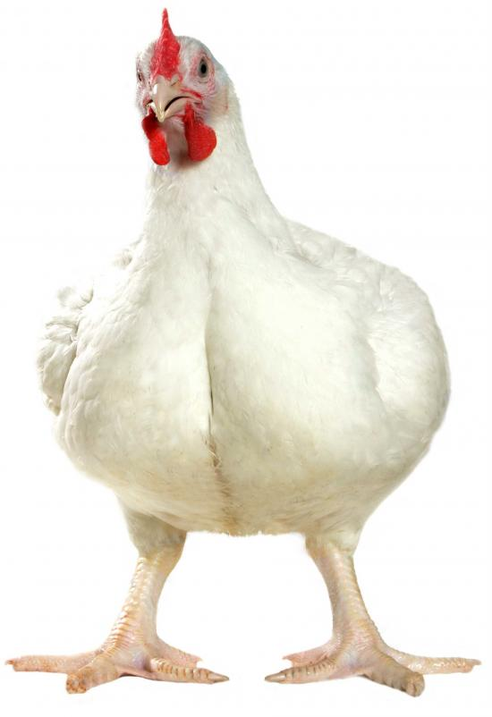
Broiler

Slide 33
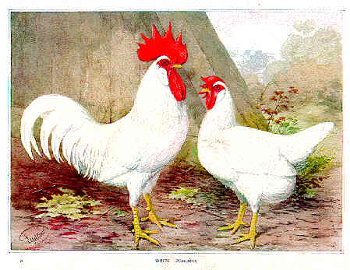
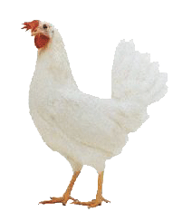
White Leghorns

Slide 34
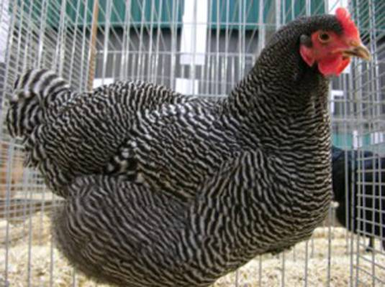
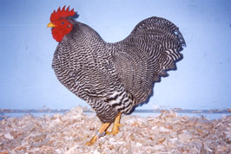
Barred Rock

Slide 35
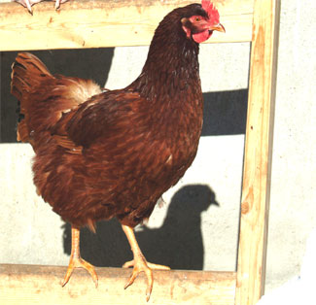
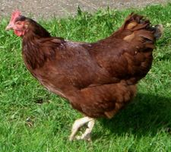
Rhode Island Red

Slide 36
Equine Industry
Uses
Show
Racing
Recreation
pleasure riding, rodeo, draft horses, etc.
Breeds (3 most popular)
Quarter horse – riding, hunting, and working cattle
Thoroughbred
Arabian

Slide 37
Aquaculture Industry
Water Quality
The key/challenge
Dissolved oxygen (DO) levels in any fish system can become so low that fish die
Measured by oxygen probes or chemical tests and reported as 0-10 ppm
Most fish can survive as low as 3 parts per million
become stressed and succumb to other problems
Rainbow trout
Require high levels of DO
Can only be cultured in oxygen –saturated water
Aerators are used to improved oxygen levels

Slide 38
Aquaculture Industry
pH
measurement of acidity or alkalinity in water
affects the toxicity of soluble nutrients in the water
Measured using a meter or litmus paper
The scale is 0-14
Neutral is 7
Below 7 is acidic
Above 7 is alkaline
Most aquatic plants and animals prefer a pH between 7 and 8

Slide 39
Aquaculture Industry
Ammonia/nitrite/nitrate
waste products of aquatic animals that must be monitored
Ammonia and nitrite can accumulate to a level that is toxic to fish
often limits commercial production
Nitrate is ultimately converted to nitrogen gas or absorbed by plants
Ammonia toxicity is dependent on pH

Slide 40
Aquaculture Production Systems
Caged Culture
Contains the aquatic animals in a small area
can be monitored for better growth rates and feeding purposes
Water quality must be monitored to insure that the fish are not stressed
fish cannot move to other sections of the pond during stressful weather conditions
Roll over
condition where a pond’s water quality suddenly changes
conditions bring less-oxygenated water to the surface causing fish to die

Slide 41
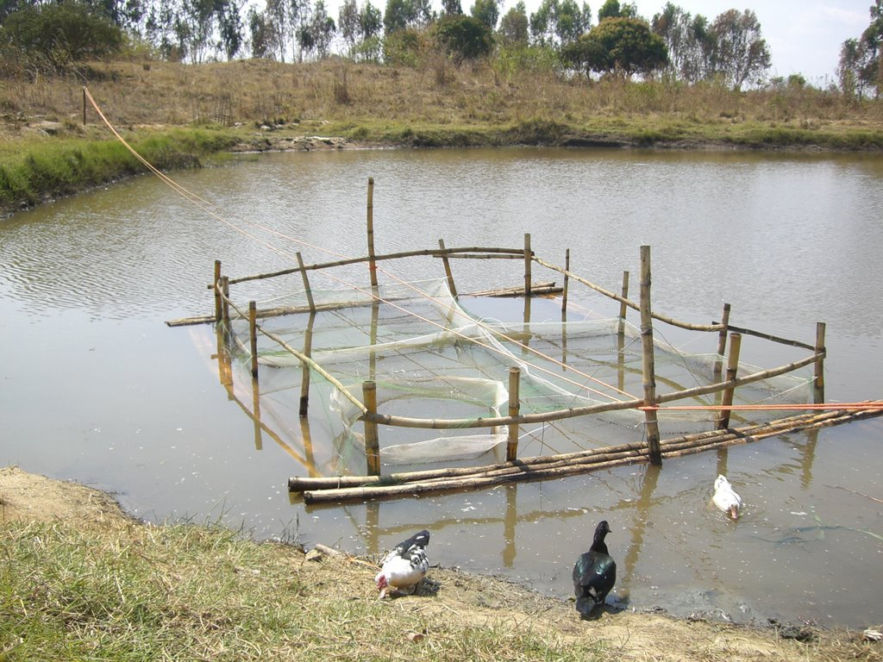

Slide 42
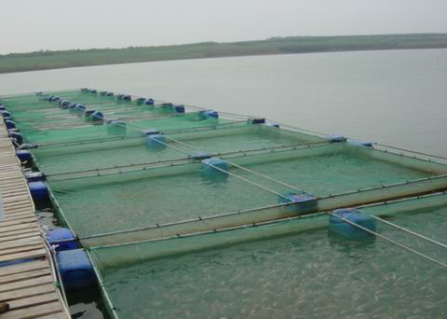

Slide 43
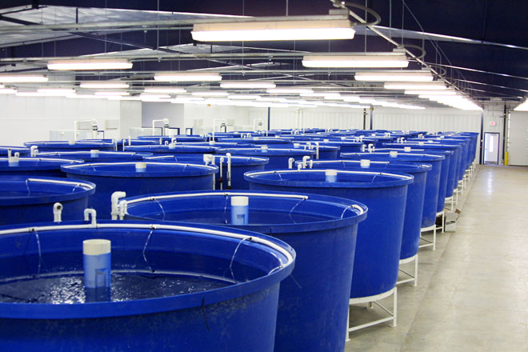
Aquaculture Production Systems
Recirculating Tanks
circulate water (including waste)
through a biological purifier and return it to the tank

Slide 44
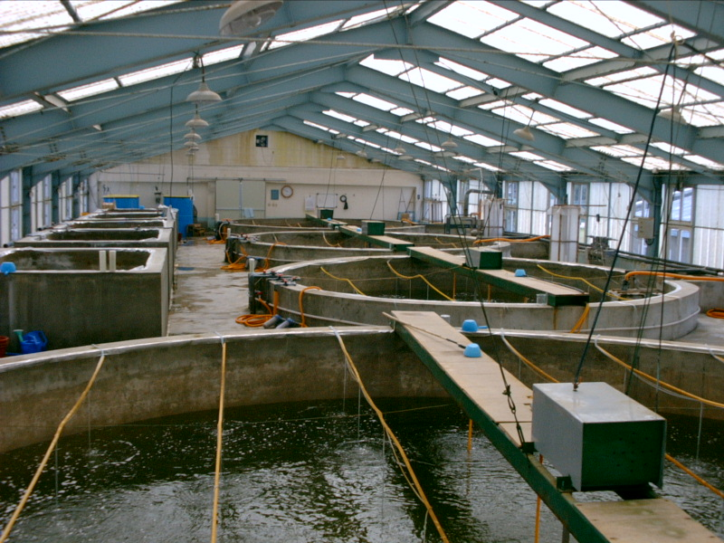

Slide 45
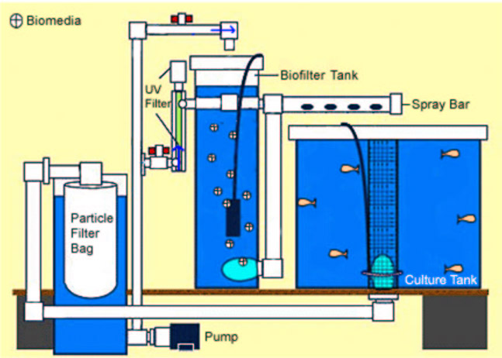

Slide 46
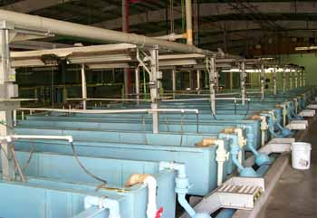
Aquaculture Production Systems
Hatcheries
supply fry or larvae to units for fingerling production

Slide 47
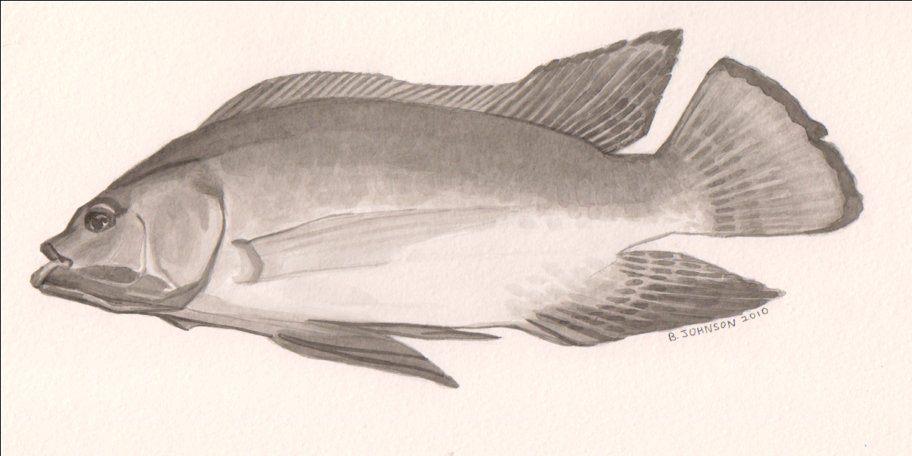
Fish adapted to aquaculture systems:
Trout
Cold water (approximately 56 degrees F)
Running water
Tilapia, catfish and striped bass
commonly raised species in warmer water

Slide 48
Animal Anatomy
Digestive system of the Ruminant
Cattle, sheep, goats, and deer
have four stomach compartments
Can tolerate more roughage

Slide 49
Animal Anatomy
Monogastric animals
Swine, horses, rabbits
One stomach compartment
similar to a human
Unable to break down large amounts of roughage
rations must be high in concentrates (ie. grains)

Slide 50
Animal Anatomy
Digestive System Poultry
No true stomachs
can only store small amounts of food
No teeth
swallowed whole, stored in the crop, and passed on to the gizzard where it is ground up
Rations must be high in food value
very efficient at converting feed

Slide 51
Animal Nutrition
Water
Regulates body temperature
dissolves and transports nutrients

Slide 52
Animal Nutrition
Protein
Builds muscle

Slide 53
Animal Nutrition
Carbohydrates
Energy
75 % of most animal rations.
Corn or other cereal grains

Slide 54
Animal Nutrition
Minerals
Calcium is one of the major minerals
Ground limestone
Needed for eggshell development
Supplied by mineral supplements
Primary aid in the development of bones and teeth.

Slide 55
Animal Nutrition
Vitamins
needed in minute quantities
help all body functions
help prevent many livestock diseases

Slide 56
Animal Nutrition
Fats
amounts of fat are required

Slide 57
Classes of Feeds
Concentrates
low in fiber and high in nutrients
Cereal grains
corn, wheat, oats, barley, rye and milo
Other sources
by-products of grain and animals

Slide 58
Classes of Feeds
Roughages
High in fiber
Dry roughage is hay
Bermuda, fescue, and alfalfa
Green roughage includes the pasture grasses
Bermuda, fescue, Kentucky bluegrass.
Silage
Roughage
Storage and fermentation of green crops
corn silage

Slide 59
Objective 4.04
Remember tools and their safety practices related to the animal industry.

Slide 60
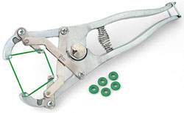
Examples of tools for use in Animal Science
Castrator
tool for sterilizing small animals
Elastrator
Scalpel

Slide 61
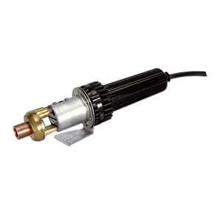
Examples of tools for use in Animal Science
Dehorner
removing horns from cattle
Electric
Chemical paste

Slide 62
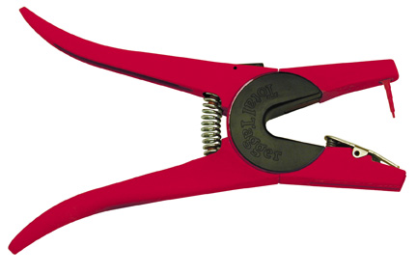
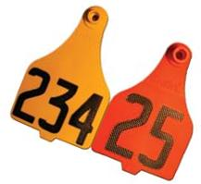
Examples of tools for use in Animal Science
Ear tagger
Labels individual animal for identification

Slide 63
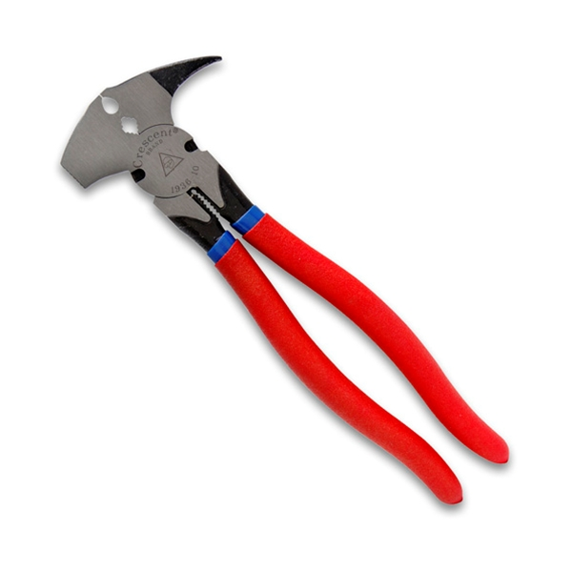
Examples of tools for use in Animal Science
Fence pliers
Building and repair of wire fences

Slide 64
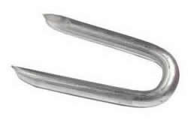
Examples of tools for use in Animal Science
Fence staple
For nailing up fencing

Slide 65
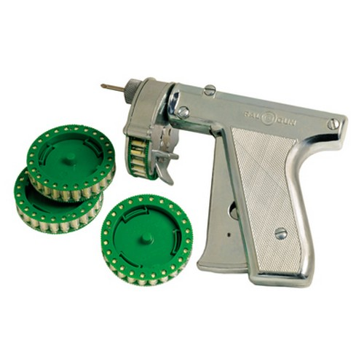
Examples of tools for use in Animal Science
Implant gun
Injects growth hormones in animals

Slide 66
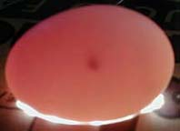
Examples of tools for use in Animal Science
Candler
used in poultry industry to examine eggs

Slide 67
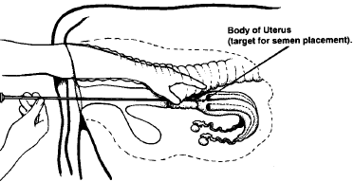
Examples of tools for use in Animal Science
Insemination rods and straws
used in artificial insemination to insert semen into female

Slide 68
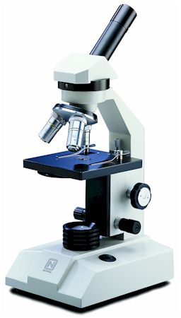
Examples of tools for use in Animal Science
Microscope
used to examine sperm for artificial insemination

Slide 69
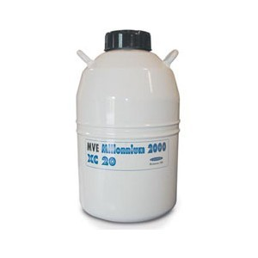
Examples of tools for use in Animal Science
Liquid nitrogen tank
used to store semen

Slide 70
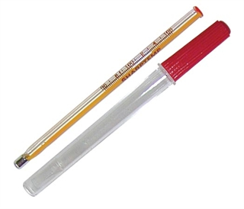
Examples of tools for use in Animal Science
Rectal thermometer
used to measure temperature of animals

Slide 71
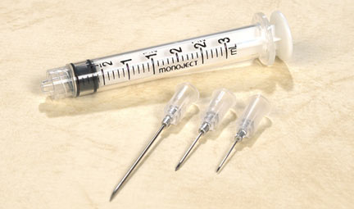
Examples of tools for use in Animal Science
Syringe and needles
used to inject medicines and vaccines into animals

