Slide 1
Environmental Science
Essential Standard 5.00: Understand the environmental science industry (water, soils, wildlife and forestry).

Slide 2
Objective 5.01
Remember careers in the environmental science industry.

Slide 3
Major career areas of Environmental Science
Water resources
  an essential nutrient for all plant and animal life
Soil resources
  the top layer of the Earth’s surface, which is suitable for the growth of plant life

Slide 4
Major career areas of Environmental Science
Wildlife
  animals that are adapted to live in a natural environment without the help of humans
Forestry
  industry that grows, manages, and harvests trees for lumber, posts, panels, paper and many other commodities

Slide 5
Environmental Science Careers
Soil conservationist
Soil scientist
Silviculturist
Forestry consultant
Loggers
Forester
Timber Cruiser
Logging foreman
Skidder operators
Urban Forester
Wildlife biologist
Wildlife manager
Wildlife officer/Game warden
Soil technician
Wildlife technician
Ecologists

Slide 6
Examples of careers in Environmental Science
Soil conservationist – assists landowners in implementing best land use practices
Soil scientist– classify soil according to the most appropriate use. Requires bachelor’s degree (4 yr)
Silviculturist– one who scientifically manages forests (specializing in the care of trees)
Forestry consultant– advises private forest land owners.
Loggers– one who harvests trees

Slide 7
Examples of careers in Environmental Science
Urban Forester– the one responsible for the health and well-being of our cities trees
Wildlife biologist– does research on habitat and wildlife and advises government agencies in establishing fish/game laws and habitat improvement programs. Requires minimum of bachelor’s degree (4 yr)
Wildlife manager – often work in government agencies , advising land owners and managing game populations on public lands
Wildlife officer/Game warden– works for the agency (North Carolina Wildlife Commission) responsible for controlling the harvest of wildlife

Slide 8
Examples of careers in Environmental Science
Soil technician – uses soil auger/soil tube to take soil samples and do technical field work
Wildlife technician – works in the field tagging animals, gathering data and assisting with research
Ecologists – studies the effects of the environment on animal life

Slide 9
Examples of careers in Environmental Science
Forester – provides assistance in managing forests for the private landowner as well as the commercial grower
Timber Cruiser – are hired by private landowners and companies to estimate tree volume on a tract of land
Logging foreman – is responsible for overseeing and managing logging operations
Skidder operators – move felled trees form the cutting site to the loading area

Slide 10
Objective 5.02
Understand biotechnology in the environmental science industry.

Slide 11
Environmental Biotechnology
Biotechnology is playing a large part in detecting and monitoring pollution and determining how much is present

Slide 12
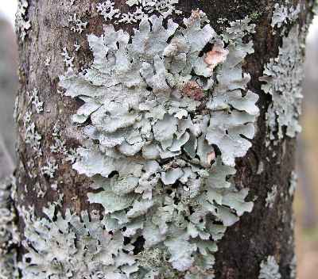
Environmental Biotechnology Examples
Indicator species
  Lichens are widely used as environmental indicators or bio-indicators
  If air is very badly polluted with sulfur dioxide, there may be no lichens present, just green algae may be found

Slide 13

Environmental Biotechnology Examples
Bioremediation
  Bacteria is used to clean up oil and fuel spills
    Oleophilic (attracted to oil) bacteria used to clean up oil spills
    Hanahan, SC, a suburb of Charleston, had an 80,000 gallon jet fuel leak from a military fuel storage facility
      fuel entered the ground and the groundwater
      Bacteria were successfully used to remediate this problem

Slide 14
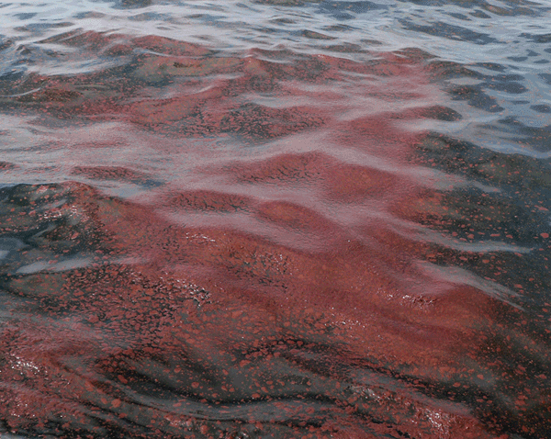
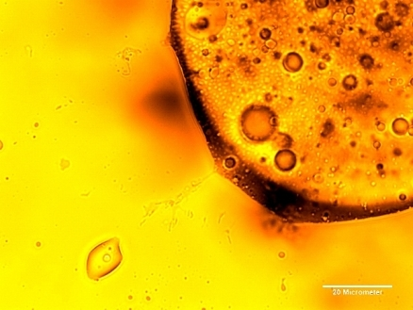
Environmental Biotechnology Examples
Biostimulation
  The Exxon Valdez clean-up
    Used the addition of nutrients
      Feed the oleophilic bacteria

Slide 15
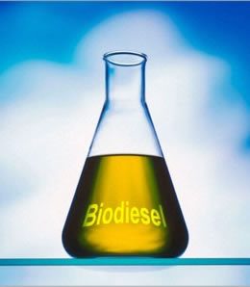
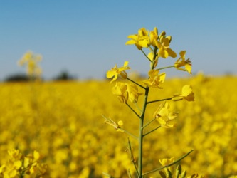
Environmental Biotechnology Examples
Biodiesel
  made from oilseeds
    Soybean
    Canola oil
  proven to decrease harmful emissions

Slide 16
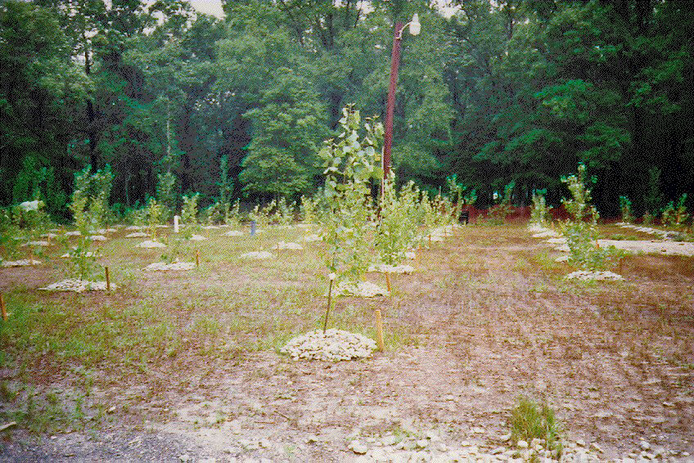
Environmental Biotechnology Examples
Phytoremediation
  Oregon Poplar Site (illegal industrial waste dumping site)
  J-Field at Aberdeen Proving Ground( disposal site of chemical warfare agents, munitions and industrial chemicals)
    used hybrid poplar trees
    remove VOC’s
      volatile organic compounds from contaminated soil

Slide 17
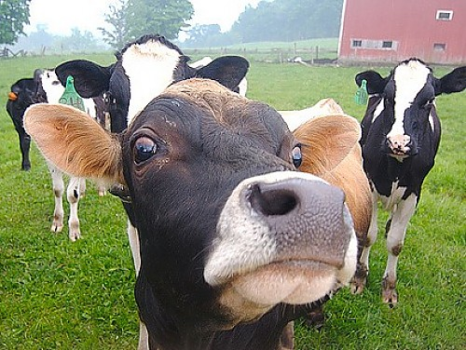
Environmental Biotechnology Examples
Genetic engineering
  bacterial strains are under development to convert solid waste from humans and livestock into sugar and fuel

Slide 18
Limitations of using bio and phytoremediation
Time
  often considered slower than chemical techniques
Applicability
  they do not apply to all situations
Fear
  those who live near treatment sites often would rather have the contaminated soil removed than treated
    Fear that the process will not uncontaminate the soil

Slide 19
Assignment
Research and report on an actual event where biotechnology was used to solve an environmental problem.
Complete:
  Write an account of the event as if it happened today. Make your response similar to something you may see posted on a blog or social media account that promotes the use of biotechnology in helping our environment.
  Where did it occur?
  Who did it affect?
  Was it solved and if so, how?

Slide 20
Objective 5.03
Understand basic environmental science principles and practices.

Slide 21
Water Resources
Potable Water
  Drinkable-free from harmful chemicals and organisms
  Most of the Earth’s water is not fresh water
Universal solvent
  it dissolves or otherwise changes most other materials

Slide 22
Water Resources
Water Cycle
  cycling of water between water sources, atmosphere, and surface areas
    Precipitation – moisture from rain or snow
    Evaporation – changing from a liquid to a gas
Watershed
  large area in which water is absorbed from rain or melting snow and from which water drains
    acts as a storage system
      absorbs excess water and releasing it slowly throughout the year
Water Table
  level below which soil is saturated with water

Slide 23
Assignment
Using a clean sheet of paper and colored markers, draw the water cycle.
Use all the components necessary to complete the cycle.

Slide 24
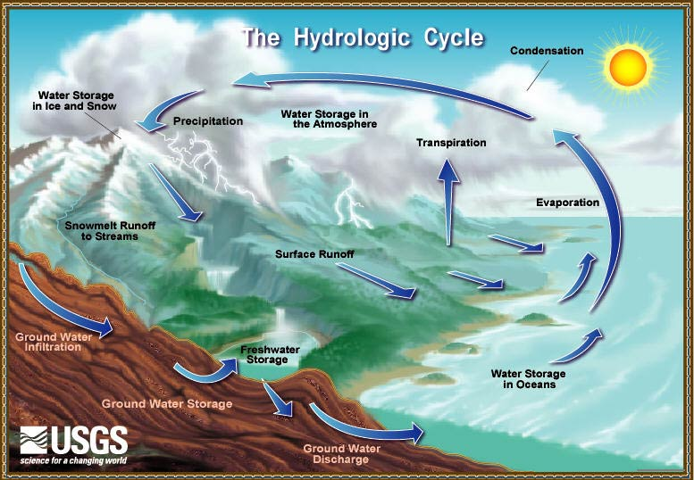

Slide 25
Water Resources
Types of Groundwater
  Capillary
    water that plant roots can absorb
  Free (gravitational)
    water that drains out of a soil after it has been wetted
  Hygroscopic
    water that is held too tightly for plant roots to absorb

Slide 26
Water Resources
Conserving Water and Improving Water Quality
  Ask the right questions
    How can we reduce water pollution?
    How can soil erosion be reduced?

Slide 27
Water Resources
What is the most productive use of water and soil without polluting or losing these essential resources?
  Good practices:
    Save clean water
      turn off water faucet while brushing teeth
    Dispose of household products carefully and appropriately.
      never pour paint down the drain as it will eventually enter the water supply
    Care for lawns, gardens and farmland carefully
      only till soil that will not erode excessively and don’t over fertilize

Slide 28
Soil
Soil Profile
  A Horizon- topsoil
    Surface layer of soil approximately 6” deep.
    Organic matter
      typically darker color
    Greatest influence on crops
  B Horizon – subsoil
    Subsurface layer
    Increase in clay content
    Greatest influence on urban uses (building sites, septic systems, etc.)
  C Horizon – parent material (bedrock)
    Releases water to the upper soil layers
    Contains larger soil particles

Slide 29
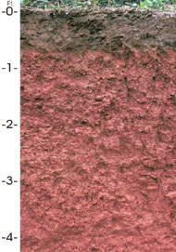
Soil Profile

Slide 30
Soil Texture
Refers to the size of soil particles
  Sand
    Largest soil particle
      Problems holding enough water for good plant growth
      Individual particles can be seen with the naked eye
    Drain well
  Silt
    Intermediate size soil particle
    Can’t be seen with naked eye
  Clay
    smallest soil particle
    holds lots of water
    may be airtight, infertile for root growth, and associated with wet soils

Slide 31
Soil Structure
Refers to the tendency of soil particles to cluster together
  Single grain
    sandy soils
  Granular
    particles cling together to form rounded aggregates
    very desirable for all soil uses
  Blocky
    particles cling together in angular aggregates
    typical of soils with high clay content

Slide 32
Soil Classification
Land capability maps are based on the physical, chemical, and topographical aspects of the land
Land Capability classes are designated by Roman Numerals I – VIII.
  Class I and II land
    best land for the most intensive cultivation of field crops
    fewest limitations and can be planted year after year
Class VII
  very steeply sloping
  best used for planting trees
3) Class VIII
  land is best suited for wildlife and recreation

Slide 33
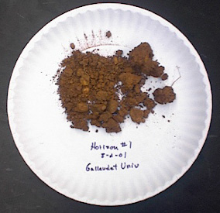
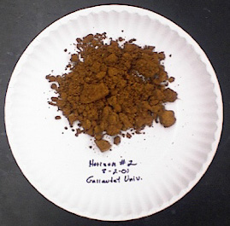
Blocky Structure

Slide 34
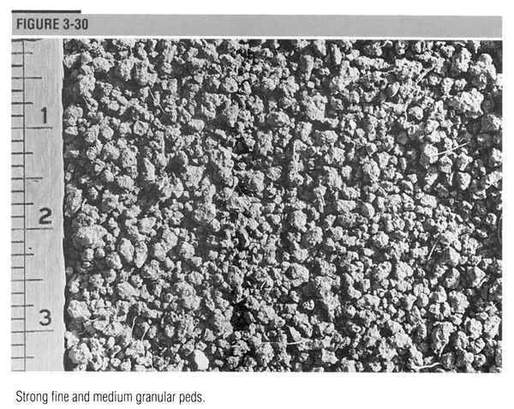
Granular

Slide 35
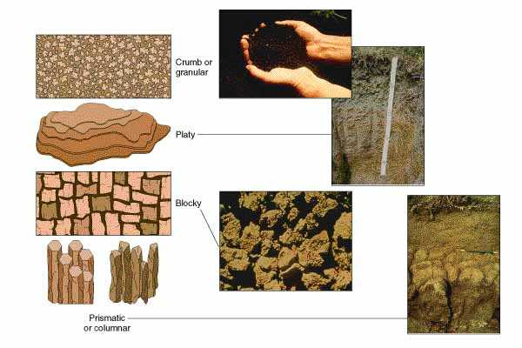
Structure

Slide 36
Soil Conservation
Two types of erosion
  Sheet – removal of layers of soil from the land.
  Gully – removal of soil that leaves trenches.
“No till”
  Crops are planted directly into the residue of a previous crop
  An effective means of erosion control
Conventional Tillage
  disturbs the soil surface by plowing
Conservation Tillage
  intermediate tillage system conventional and no-till

Slide 37
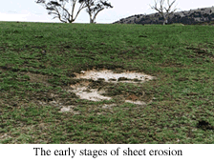
Soil Conservation
Erosion
  Sheet
  Gully

Slide 38
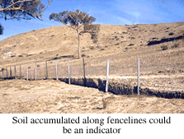
Sheet Erosion

Slide 39
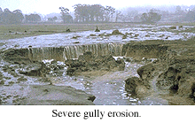
Gully Erosion

Slide 40
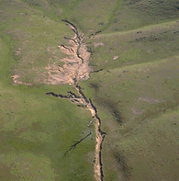
Gully Erosion

Slide 41
Wildlife Management
Benefits of Wildlife
  Hunting/Fishing
  Viewing
  Photography
  Environmental Indicator

Slide 42
Wildlife Environments
Farm
  By-product of the farming operation
    Leaving crop residue standing can increase food supply
    Creating brush piles when harvesting trees provides shelter and cover
Forest
  Difficult to manage
  Plans should be developed so that timber and wildlife can exist in populations large enough to be sustained and harvested
Wetland
  Wetlands are the most productive wildlife management area

Slide 43
Wildlife Environments
Stream
  difficult to manage due to continuous flow of water
Ponds/Lakes
  easier to manage than streams due to water standing and not flowing
Backyards (urban wildlife)
  birds, butterflies and small mammals can be attracted through use of feeders, houses and proper landscaping

Slide 44
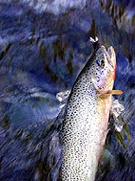
Trout

Slide 45
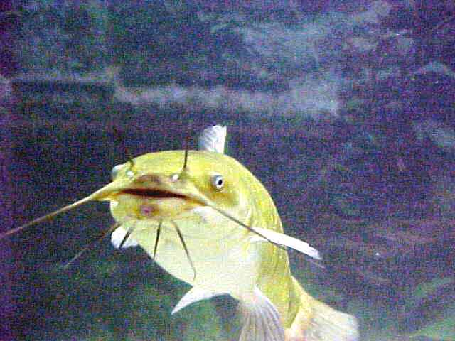
Catfish

Slide 46
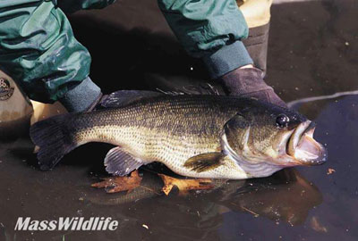
Largemouth Bass

Slide 47
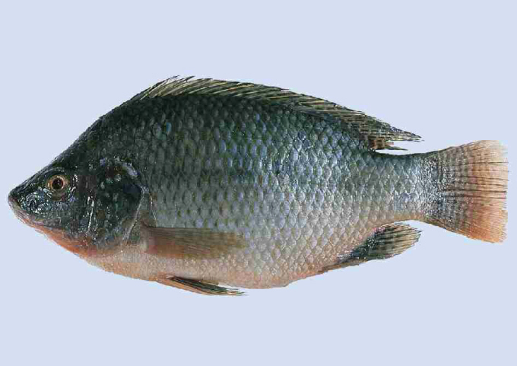
Tilapia

Slide 48
Carrying Capacity
Number of wildlife that can be supported
Exceeding the carrying capacity:
  Wildlife is affected by malnutrition, disease, and a reduction in the reproduction cycle
  Habitat quality decreases
    A pond with a carrying capacity of 20 fish will decrease if 50 fish are competing for the same food, habitat and oxygen

Slide 49
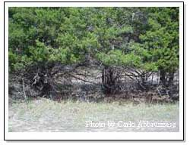
Deer Overpopulation
Browse Line in Texas

Slide 50
Hunting and Fishing
Helps to maintain the proper carrying capacity
Prevents:
  overpopulation
  malnutrition
  disease
  reduction in reproduction
  decreased wildlife population

Slide 51
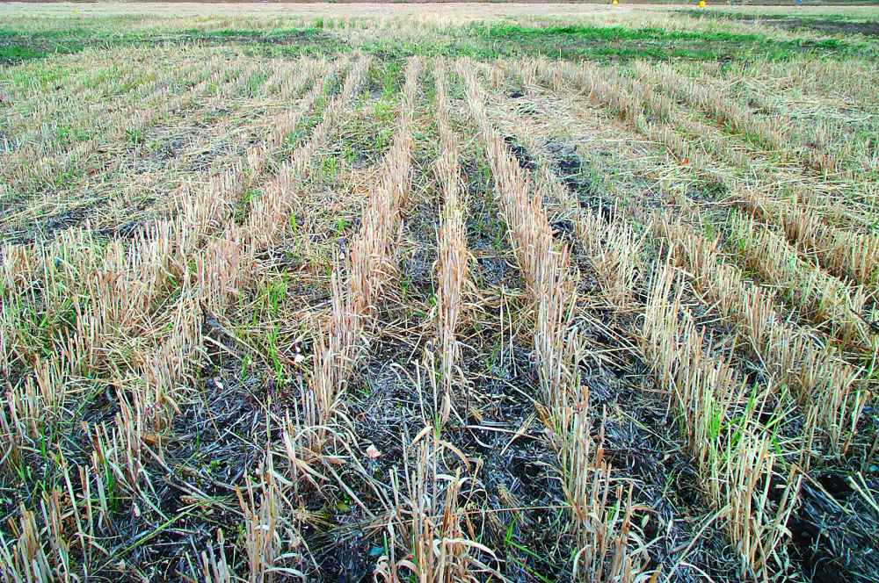
Crop Residue

Slide 52
Examples of Wildlife in North Carolina
Hunted Species
  deer, ducks, bear, quail, doves, rabbits
Songbirds
  Cardinal, robin, chickadee, Eastern bluebird
Birds of prey
  Red- tailed hawk, Turkey and black vulture
Fish (freshwater)
  largemouth and smallmouth bass, bream, catfish, crappie

Slide 53
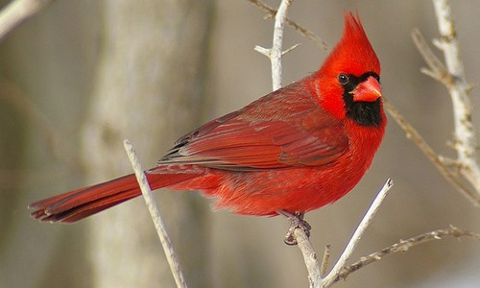
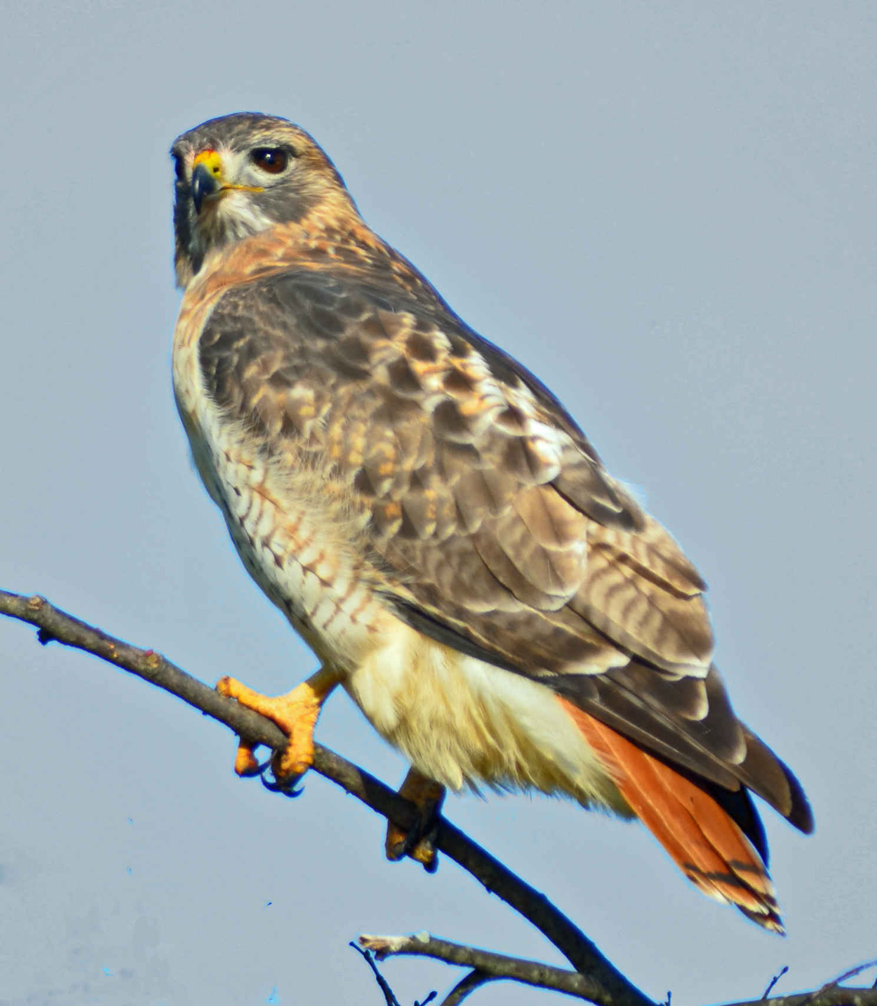
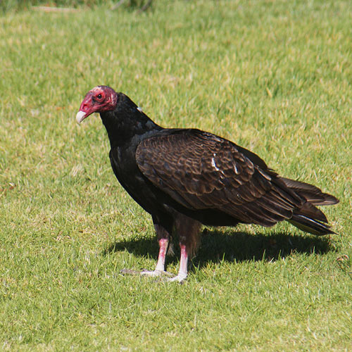

Slide 54
Forest Management
Northern coniferous forest
  largest region and produces large amounts of pulpwood
Pacific Coast Forest
  most productive of the forest regions
  some of the largest trees in the world
  Douglas Fir
    one of the most important commercially grown trees

Slide 55
Forest Management
Southern forests
  Most potential for meeting the future lumber and pulpwood needs of the US
    Conifers
      Virginia, loblolly, shortleaf, longleaf and slash pines
    Hardwoods
      Oak, poplar, maple and walnut

Slide 56
Importance of Forests
Recreation
  hunting, hiking
Wood products
  lumber, pulpwood, etc.
Wildlife habitat
Filter
  water and air

Slide 57
Silviculture
Scientific forest management techniques
Managing growing timber
  Prescribed thinning
    remove some trees when competition slows the growth of all trees
  Prescribed burning
    reduce the risk of wildfires
    eliminates forest litter (fuel)

Slide 58
Silviculture
Harvesting Timber
  Clear cutting
    system of harvesting trees where all of the trees in an area are removed
  Selection cutting
    recommended for a forest of trees consisting of different ages and species
Replacing trees
  Replanting seedlings is a surer method of replacing trees
  Natural seeding
    least expensive

Slide 59
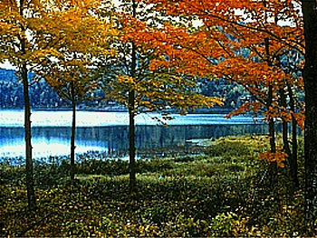
Deciduous

Slide 60
Identification and Uses of Important Tree Species in NC
Hardwoods – deciduous trees
  Ash
    baseball bats, handles
    opposite pinnately compound leaves
  White oak
    flooring, furniture
    alternate, pinnately lobed leaves,
  Red Maple
    lumber, veneer, cabinets
    opposite, palmately lobed,3-5 lobed

Slide 61
White Ash

Slide 62
River Birch

Slide 63
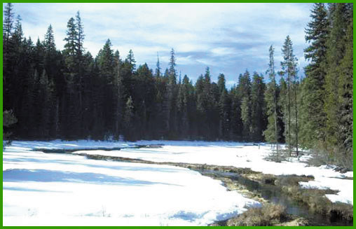
Coniferous

Slide 64
Identification and Uses of Important Tree Species in NC
Conifers (softwoods) – needle-type evergreens
  Frazier fir
    Most important commercially grown Christmas Tree in NC (mountains)
    dark green ½-1” long singular needle
  Loblolly pine
    pulpwood and plywood
    3 needles/bundle, needles 6-9” long needles.
  Longleaf pine
    lumber, pulpwood and plywood
  3 needles/bundle, 8-18” long needles

Slide 65
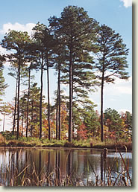
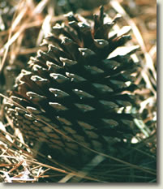
Loblolly pine

Slide 66
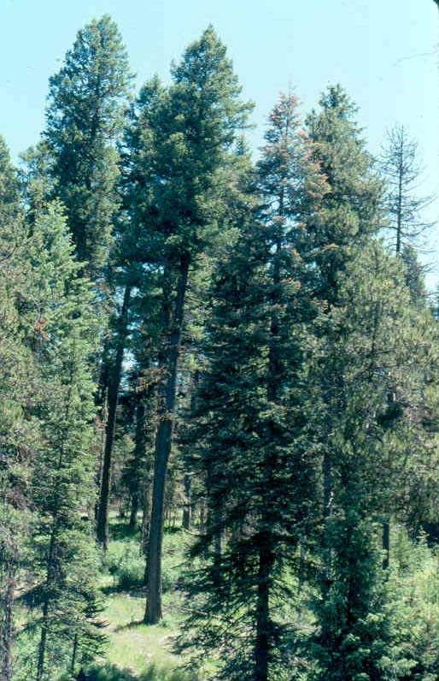
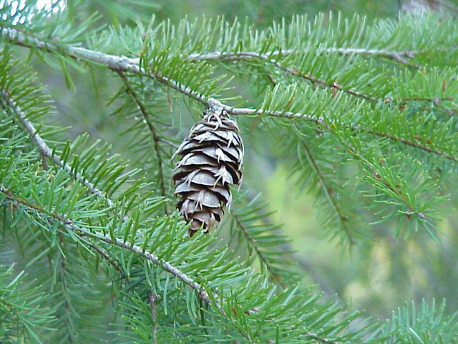
Douglas fir

Slide 67
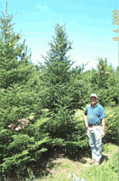
Fraser fir

Slide 68
Measurement of Trees and Lumber
Pulpwood
  DBH, merchantable height in feet, cords
Sawtimber
  DBH, 16 foot logs, board feet
Lumber
  1 board foot = 144 cubic inches

Slide 69
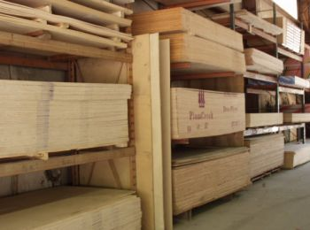
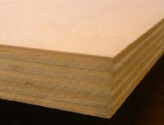
Plywood

Slide 70
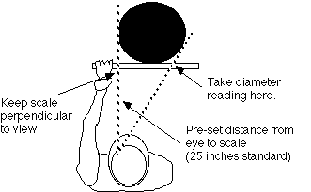
Diameter Breast Height (DBH)

Slide 71
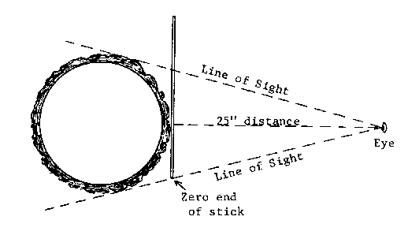
Diameter Breast Height (DBH)

Slide 72
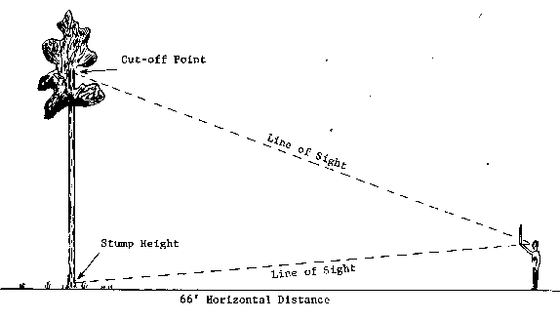
Tree Height

Slide 73
Calculating Board Feet
Measurement of volume
Formula
# pieces X t (inches) X w (inches) X l (feet)
12
bf=

Slide 74
Calculating Board Feet
Problem:
  calculate board feet if you have 5 pieces of lumber that are 2 inches thick, 4 inches wide, and all are 8 feet long
5 X 2” X 4” X 8’
12
bf=

Slide 75
Calculating Board Feet
Answer:
5 X 2” X 4” X 8’
12
bf=
bf= 26.6

Slide 76
Objective 5.04
Remember tools and their safety practices related to the environmental science industry.

Slide 77
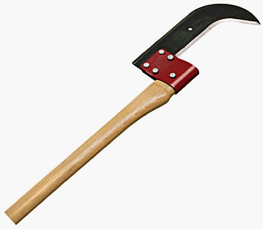
Examples of tools used in Environmental Science
Bush axe
  Cutting bushes and under growth

Slide 78
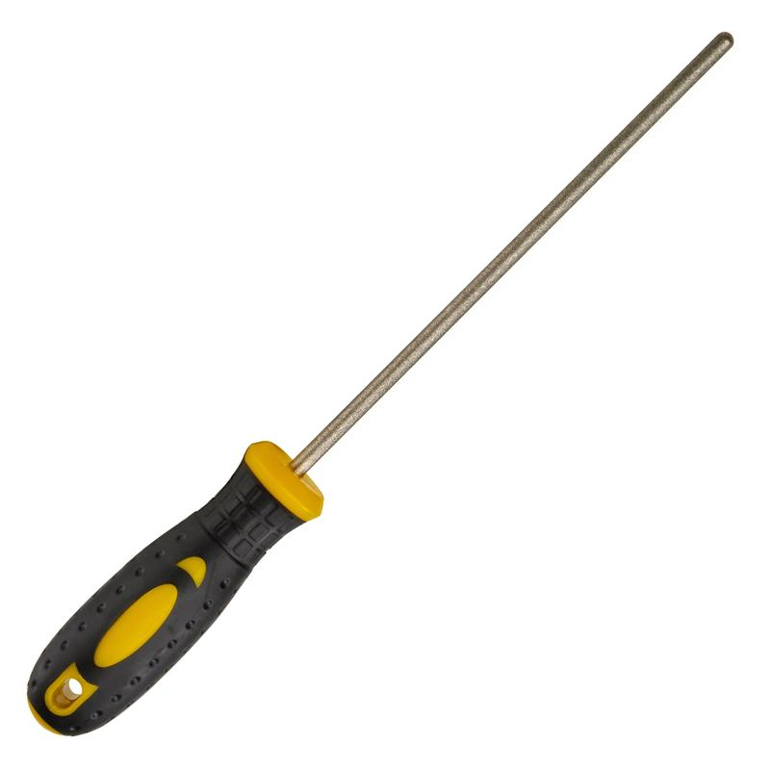
Examples of tools used in Environmental Science
Chain saw file
  Sharpening chain saw chain

Slide 79
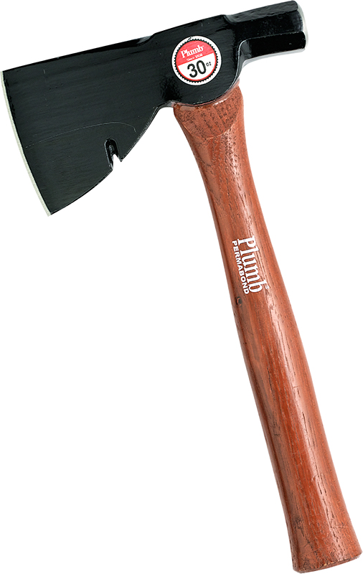
Examples of tools used in Environmental Science
Half hatchet
  Cutting and fitting firewood

Slide 80
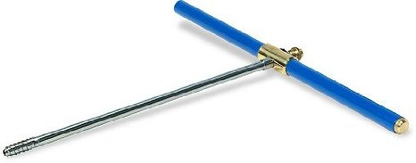
Examples of tools used in Environmental Science
Increment borer
  Checking growth rate of trees

Slide 81
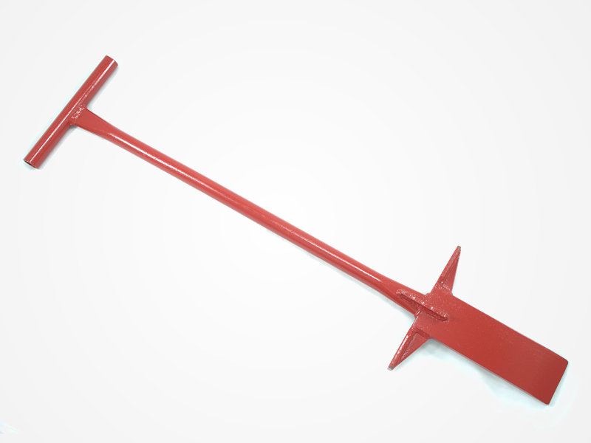
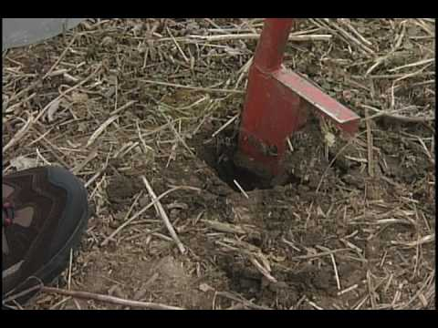
Examples of tools used in Environmental Science
Planting bar
  Setting out tree seedlings

Slide 82
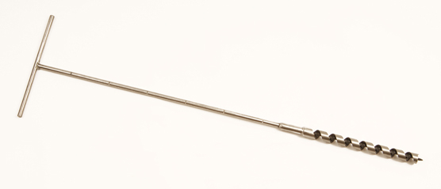
Examples of tools used in Environmental Science
Soil auger
  Boring into soil to get samples

Slide 83
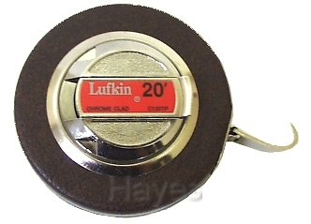
Examples of tools used in Environmental Science
Tree diameter tape
  Measure circumference of trees

Slide 84
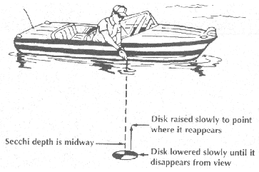
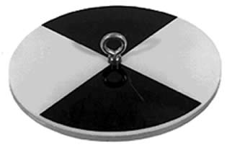
Examples of tools used in Environmental Science
Secchi disc
  measures turbidity of water

Slide 85
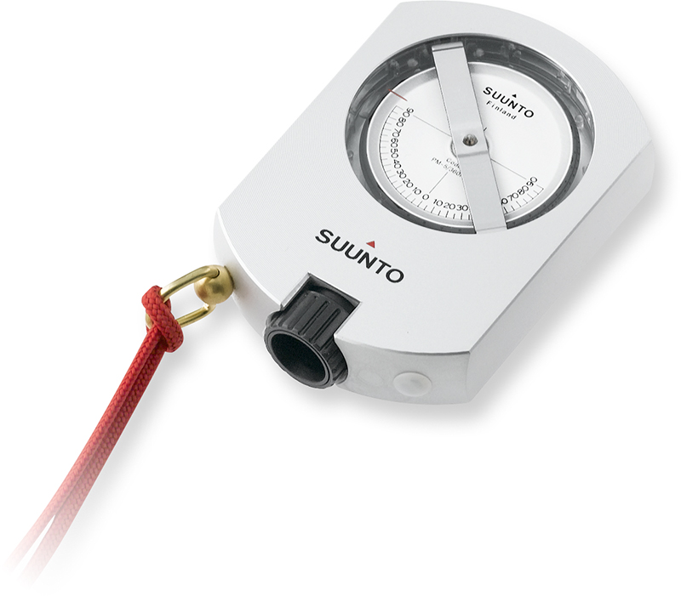
Examples of tools used in Environmental Science
Clinometer
  used to measure the height of a tree

Slide 86
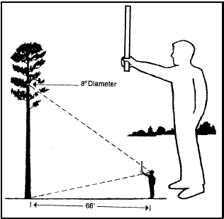

Examples of tools used in Environmental Science
Tree scale stick
used to measure tree diameter and height

